Slide 1
Hybridization
Molecular Tinkertoy geometry

Slide 2
Linear Combination of Atomic Orbitals
Combine disparate orbitals mathematically to give equivalent orbitals
Interchanged by a rotation or reflection
Combined orbitals are “hybrids”
Named by component orbitals
Different combinations of the same orbitals

Slide 3
Linear Combination
Combine a set of terms by multiplying each by a coefficient and adding the products
Such as ax + by + cz
Linear combination of x, y, and z

Slide 4
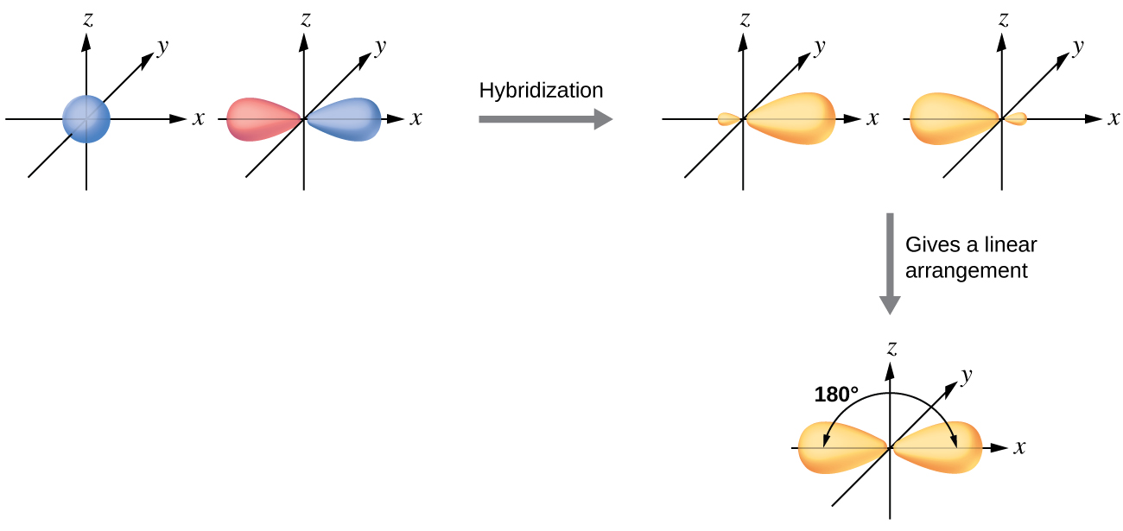
s + p = sp hybrid
Source: Openstax Chemistry, 2 Ed.

Slide 5
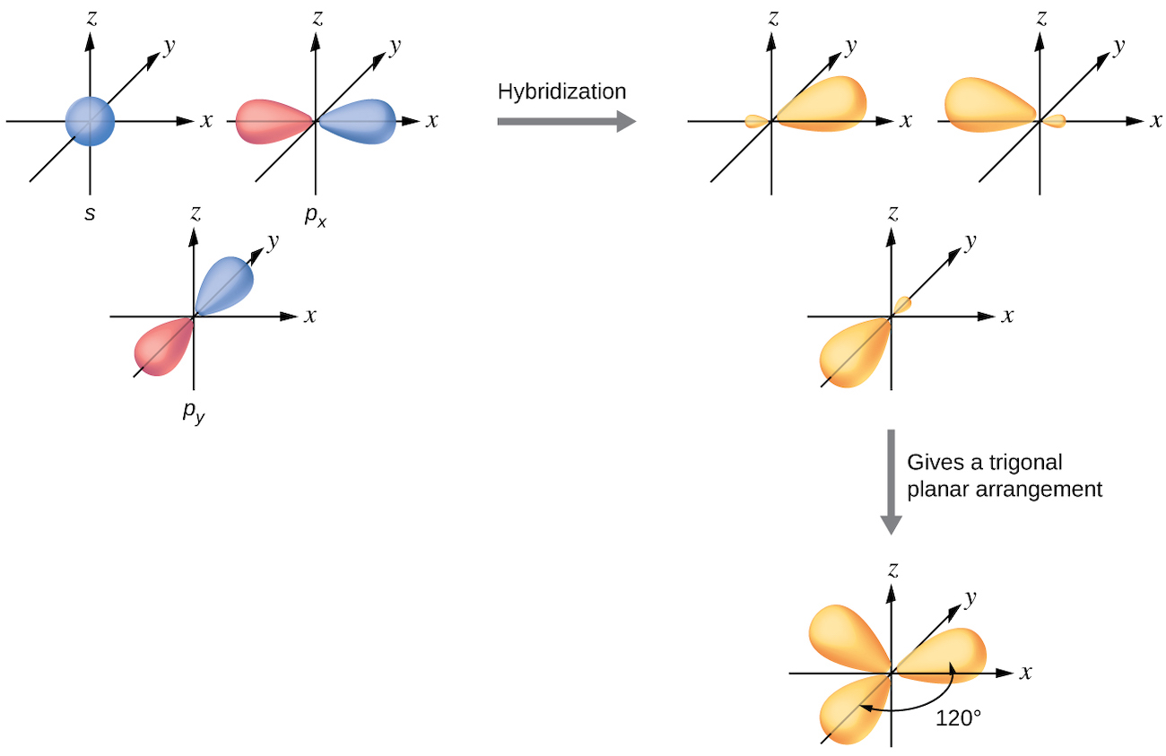
s + 2p = sp²
Source: Openstax Chemistry, 2 Ed.

Slide 6
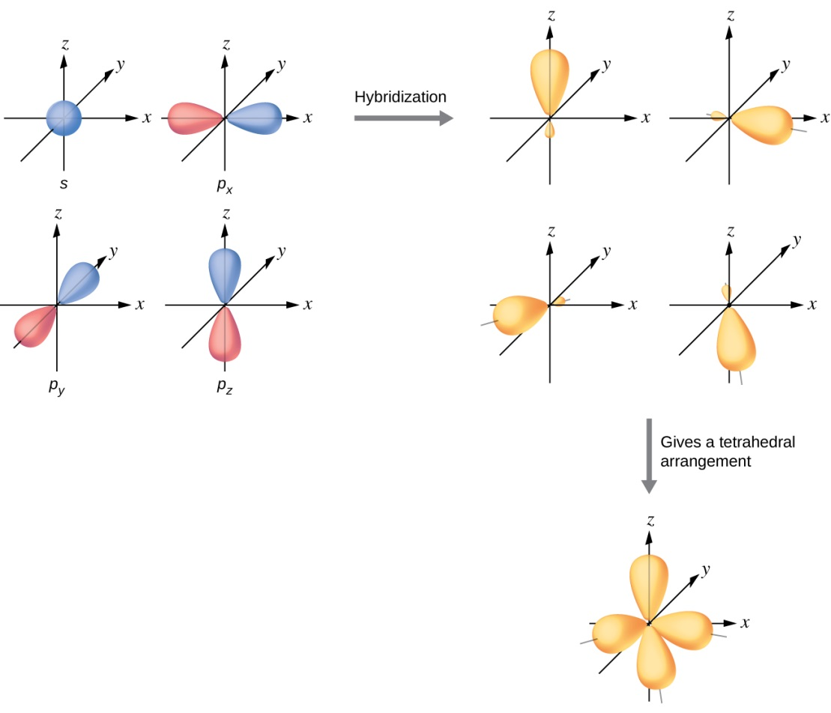
s + 3p = sp³
Yes, OpenStax, still.

Slide 7
Bonding Geometries
sp linear
sp² trigonal planar
sp³ tetrahedral

Slide 8
Multiple Bonds
determine which orbitals hybridize

Slide 9
Single bonds are σ bonds
Greek lowercase sigma = σ
No angular nodes about the bond axis
Combining the bonding atoms’s orbitals end-on

Slide 10
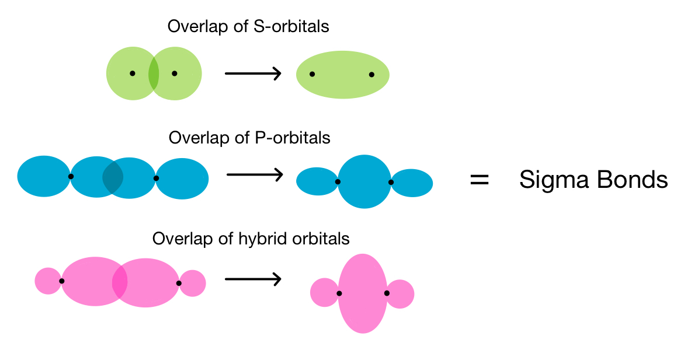
Source: Caroline Monahan, expii.com

Slide 11
Double and Triple bonds are π bonds
Greek lowercase pi = π
One nodal plane along the bond axis
Combining the bonding atoms’s orbitals side-on

Slide 12
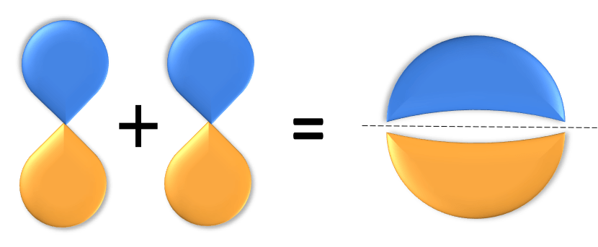
Source: Cassie Gates, expii.com

Slide 13
Yes, Delta bonds exist
Beyond the scope of this course
Two nodal planes along the bond axis
Face-on combination of d orbitals
Can happen with transition metal compounds

Slide 14
Which Orbitals Hybridize?
All the orbitals that don’t form π bonds
H
H
..
H–C≡N:
H–C=O
..
H–C–H
H
sp
sp²
sp³
What if an atom is more than 4-coordinate?

Slide 15
Shapes of Molecules
Molecular Shape of You

